Slide 1
CHAPTER 8
HASHING
All the programs in this file are selected from
Ellis Horowitz, Sartaj Sahni, and Susan Anderson-Freed
“Fundamentals of Data Structures in C”,

Slide 2
Symbol Table
Symbol table is used widely in many applications
Dictionary is a kind of symbol table
Compiler, assemblers, networking
In general, the following operation are performed on a symbol table
Determine if a particular name is in the table
Retrieve the attributes of that name
Modify the attributes of that name
Insert a new name and its attributes
Delete a name and its attributes

Slide 3
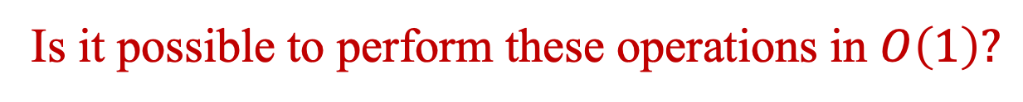
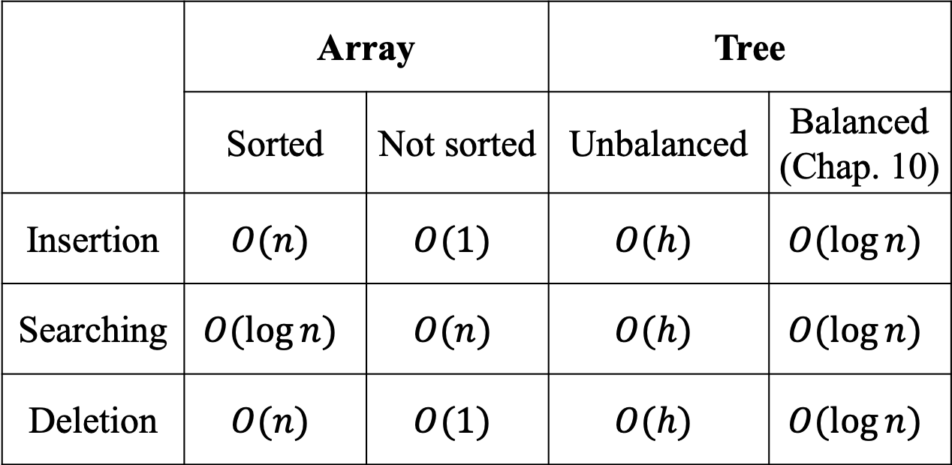
Performance Comparison of Arrays and Trees
 | Array |  | Tree
 | Sorted | Not sorted | Unbalanced | Balanced (Chap. 10)
Insertion | $$O(n)$$ | $$O(1)$$ | $$O(h)$$ | $$O(\log{n})$$
Searching | $$O(\log{n})$$ | $$O(n)$$ | $$O(h)$$ | $$O(\log{n})$$
Deletion | $$O(n)$$ | $$O(1)$$ | $$O(h)$$ | $$O(\log{n})$$
Is it possible to perform these operations in $O\left(1\right)?$

Slide 4
Static Hashing
0 | 10
1
2
3 | 23
4 | 24
5 | 35
6 | 46
7
8 | 18
9
Hash function: map a key into a table index
Example:
Key values: 18 23 35 46 24 10
Hash function: h(k) = k mod 10

Slide 5
Static Hashing
0 | 70
1
2
3
4
5 | 95
6
7
8
9
Hash function: map a key into a table index
Example:
Key values: 95 70 65 80 90 85
Hash function: h(k) = k mod 10
Two records (keys) may attempt to insert into the same bucket (position)
How to handle the event? Discussed later

Slide 6
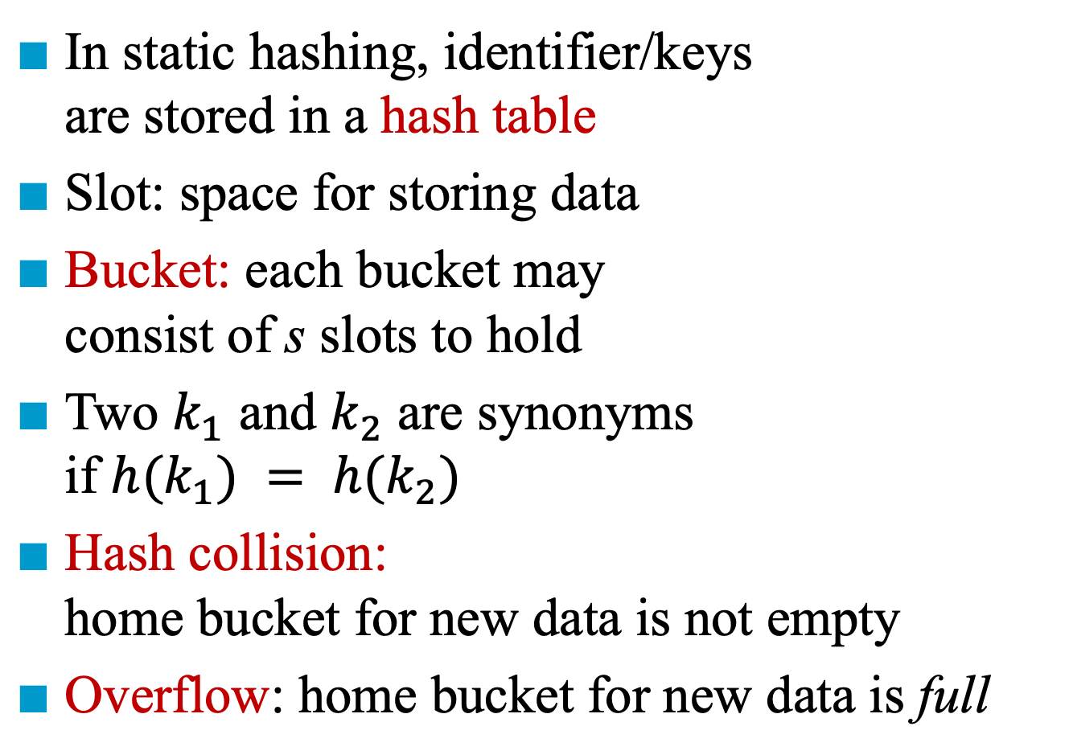
Hash Table
Slot 1
Slot 2
Bucket 0
acos | atan
char | ceil
define
exp
float | floor
…
In static hashing, identifier/keys are stored in a hash table
Slot: space for storing data
Bucket: each bucket may consist of s slots to hold
Two $k_{1}$ and $k_{2}$ are synonyms if $h(k_{1}) = h(k_{2})$
Hash collision: home bucket for new data is not empty
Overflow: home bucket for new data is full
Bucket 1
Bucket 2
Bucket 3
Bucket 4
Bucket 5
Bucket 6
Bucket 25

Slide 7
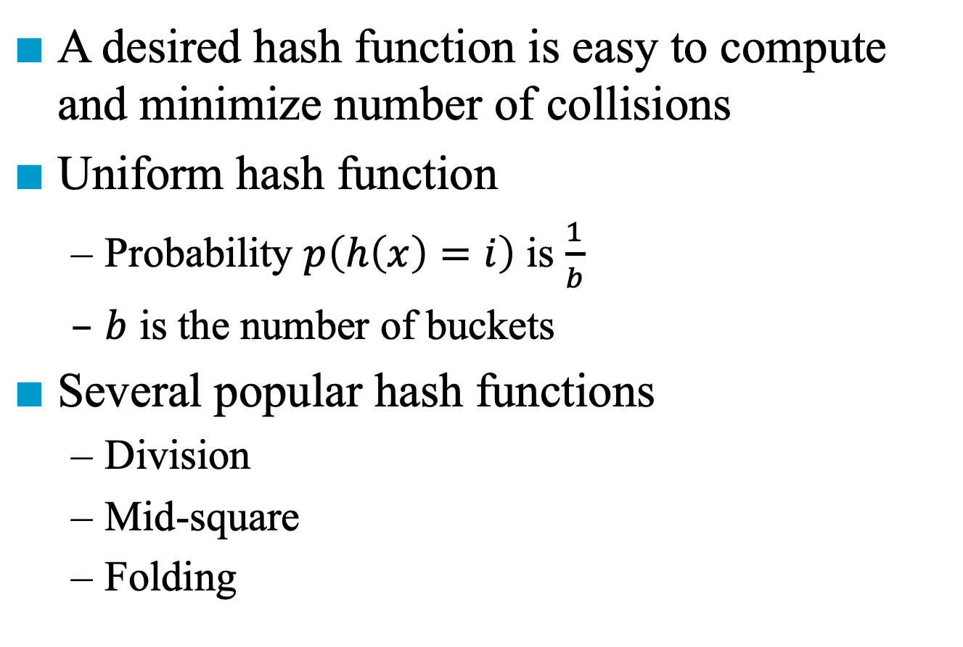
Desired Hash Functions
A desired hash function is easy to compute and minimize number of collisions
Uniform hash function
Probability $p\left(h\left(x\right)=i\right)$ is $\frac{1}{b}$
$b$ is the number of buckets
Several popular hash functions
Division
Mid-square
Folding

Slide 8
Division
h(k) = k mod D (i.e., remainder)
Since the bucket address is from 0 to b-1 if there are b buckets, usually D = b
If D is even, it is not good
A bias toward either odd or even
If D is multiple of 5, it is not good
A bias toward 0 or 5 (e.g., grade)
Prime numbers are better choices for D
For most practical dictionaries, D is a good candidate if it has no prime factor smaller than 20

Slide 9
Mid-square
Square the key the then use an appropriate number of bits from the middle of the square
Example:
Key k = 113586, b = 10000, where 9999 is the largest bucket address
Square the key, and then extract the middle 4 digits
h(k) = 1779
1 | 2 | 9 | 0 | 1 | 7 | 7 | 9 | 3 | 9 | 6

Slide 10
Folding
The key k is partitioned into several parts, all of the same length. These partitions are then added together to obtain the hash address for k
Two methods:
Shift folding
P₁
P₂
P₃
P₄
P₅
1 | 2 | 3 | 2 | 0 | 3 | 2 | 4 | 1 | 1 | 1 | 2 | 2 | 0
Folding at the boundaries
P₁ | 123
P₂ | 203
P₃ | 241
P₄ | 112
P₅ | 20
P₁ | 123
P₂ | 302
P₃ | 241
P₄ | 211
P₅ | 20
699
897

Slide 12
Overflow Handling
An overflow occurs when the home bucket for a new pair (key, element) is full
Two methods for handling overflows:
Open addressing: Search the hash table in some systematic fashion for a bucket that is not full
Linear probing
Quadratic probing
rehashing
Chaining: Each bucket keeps a linked list of all pairs to the same bucket address
Linked list

Slide 13
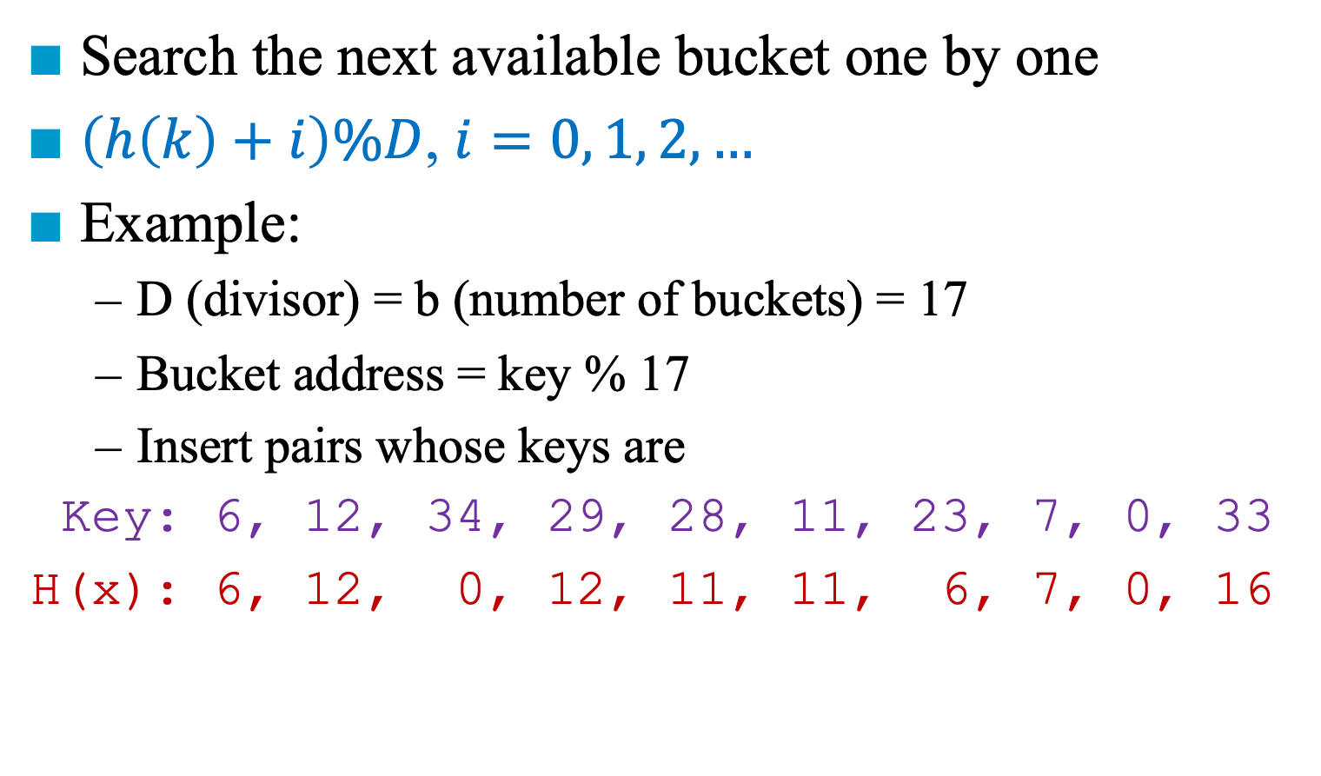
Linear Probing (Linear Open Addressing)
Search the next available bucket one by one
$\left(h\left(k\right)+i\right)\%D$, $i=0, 1, 2, …$
Example:
D (divisor) = b (number of buckets) = 17
Bucket address = key % 17
Insert pairs whose keys are
Key: 6, 12, 34, 29, 28, 11, 23, 7, 0, 33
H(x): 6, 12, 0, 12, 11, 11, 6, 7, 0, 16
0
4
8
12
16
34 | 0 |  |  |  |  | 6 | 23 | 7 |  |  | 28 | 12 | 29 | 11 |  | 33

Slide 14
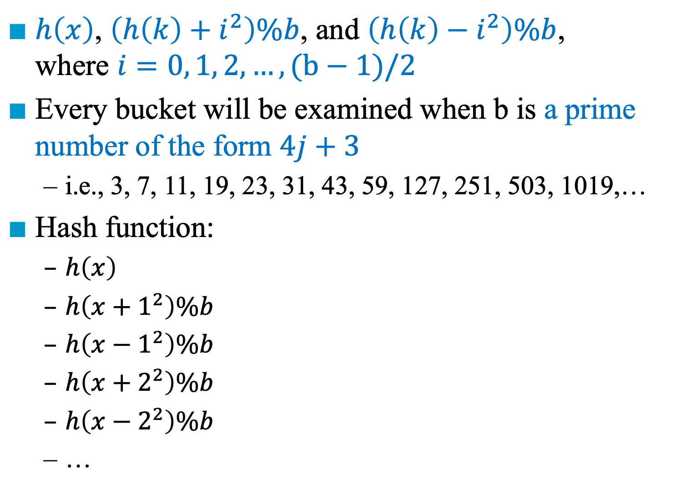
Quadratic Probing
$h\left(x\right)$, $\left(h\left(k\right)+i^{2}\right)\%b$, and $\left(h\left(k\right)−i^{2}\right)\%b$, where $i=0, 1, 2, …, (b−1)/2$
Every bucket will be examined when b is a prime number of the form $4j+3$
i.e., 3, 7, 11, 19, 23, 31, 43, 59, 127, 251, 503, 1019,…
Hash function:
$h\left(x\right)$
$h\left(x+1^{2}\right)\%b$
$h\left(x−1^{2}\right)\%b$
$h\left(x+2^{2}\right)\%b$
$h\left(x−2^{2}\right)\%b$
…
Example:
b = 7, (b-1)/2 = 3
i = 1, 2, 3
Examine: 0, 1, -1, 4, -4, 9, -9 (%7)
Equivalent to 0, 1, 6, 4, 3, 2, 5

Slide 15
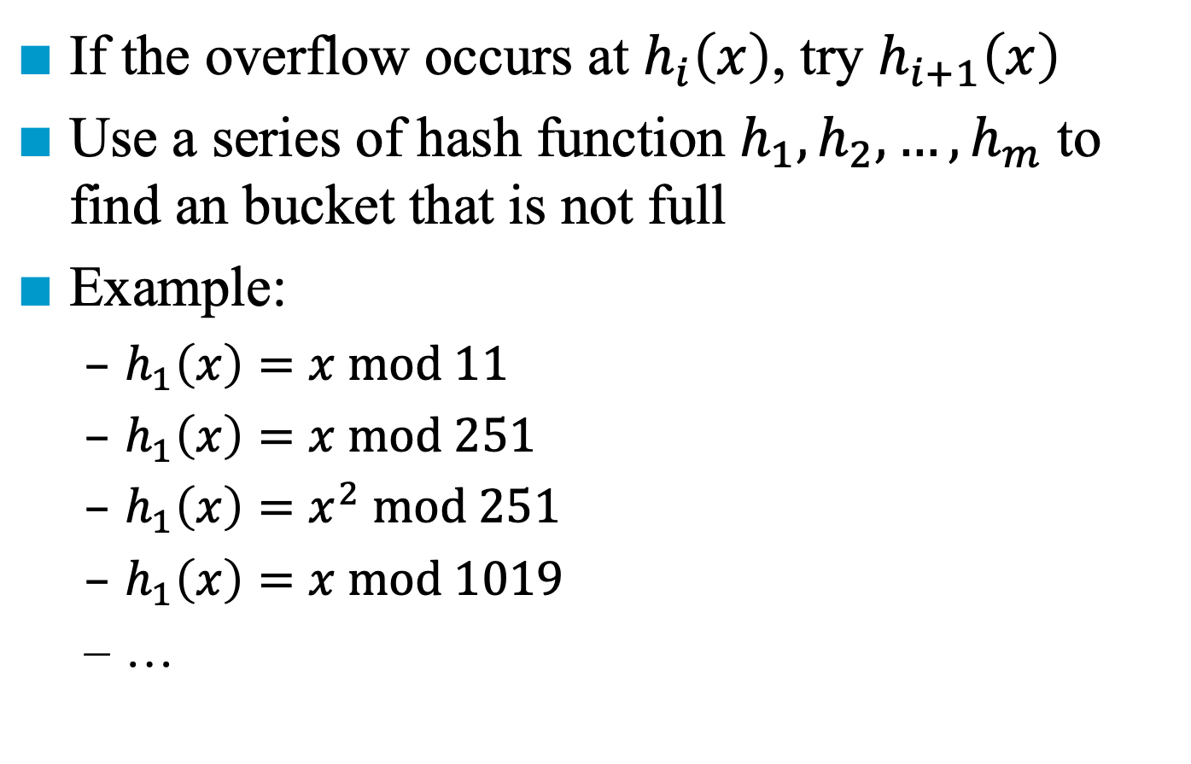
Rehashing
If the overflow occurs at $h_{i}\left(x\right)$, try $h_{i+1}\left(x\right)$
Use a series of hash function $h_{1}, h_{2},…,h_{m}$ to find an bucket that is not full
Example:
$h_{1}\left(x\right)=x mod 11$
$h_{1}\left(x\right)=x mod 251$
$h_{1}\left(x\right)=x^{2} mod 251$
$h_{1}\left(x\right)=x mod 1019$
…

Slide 17
Chaining
[0]
0
34
Disadvantage of linear probing
Comparison of keys with different hash values
Use linked lists to connect the keys with the same hash value and to increase the capacity of a bucket
Key % 17
[4]
6
23
7
[8]
11
28
[12]
12
29
[16]
33

Slide 19
Dynamic Hashing
Also called extended hashing
Limitations of static hashing
When that table is to be full, overflows increase
As overflow increases, the performance decreases
We cannot just copy entries from smaller into a corresponding buckets of a bigger table
Allow the size of dictionary to grow and shrink
The size of hash table can be changed dynamically
Hash function: h ( ) → h’( )
Size of hash table: m → m’

Slide 20
Dynamic Hashing Using Directories
The hash function h(k) transforms k into 6-bit binary integer
k | h(k)
A0 | 100 000
A1 | 100 001
B0 | 101 000
B1 | 101 001
C1 | 110 001
C2 | 110 010
C3 | 110 011
C5 | 110 101
B4 | 101 100
B5 | 101 101

Slide 21
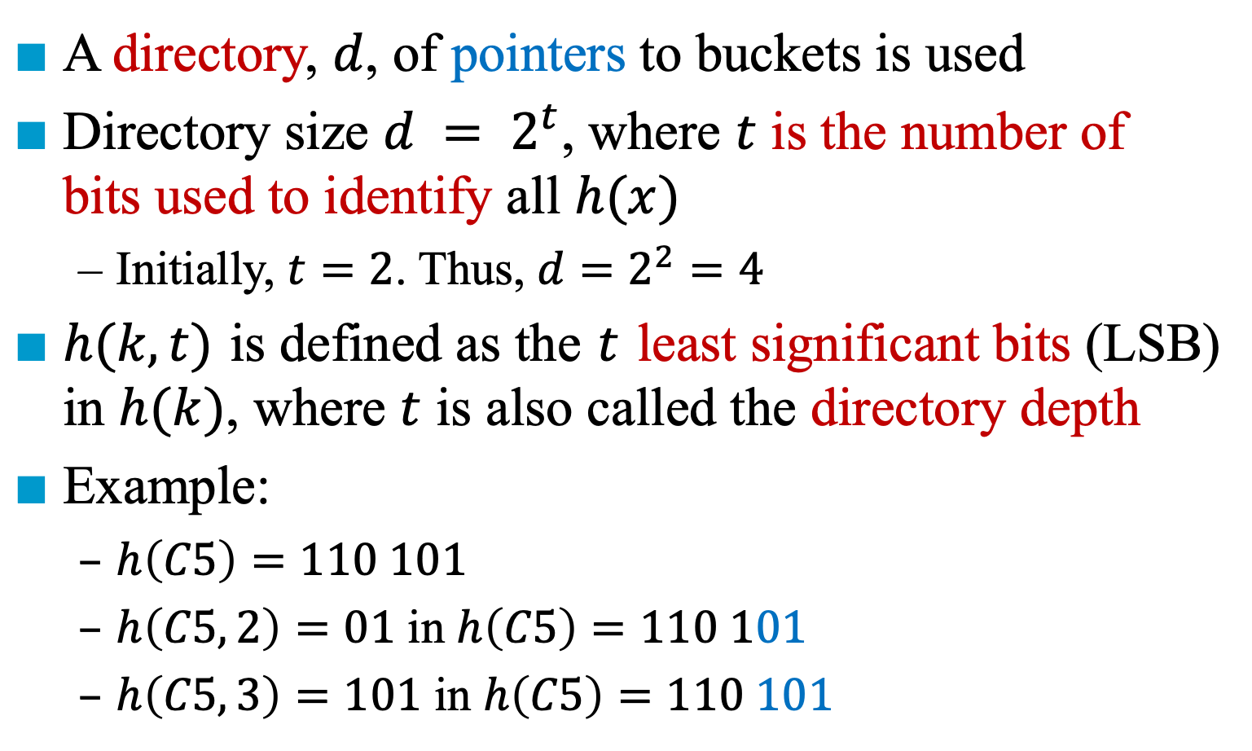
Dynamic Hashing Using Directories
A directory, $d$, of pointers to buckets is used
Directory size $d = 2^{t}$, where $t$ is the number of bits used to identify all $h(x)$
Initially, $t=2$. Thus, $d=2^{2}=4$
$h(k,t)$ is defined as the $t$ least significant bits (LSB) in $h(k)$, where $t$ is also called the directory depth
Example:
$h\left(C5\right)=110 101$
$h\left(C5, 2\right)=01$ in $h\left(C5\right)=110 101$
$h\left(C5, 3\right)=101$ in $h\left(C5\right)=110 101$

Slide 22
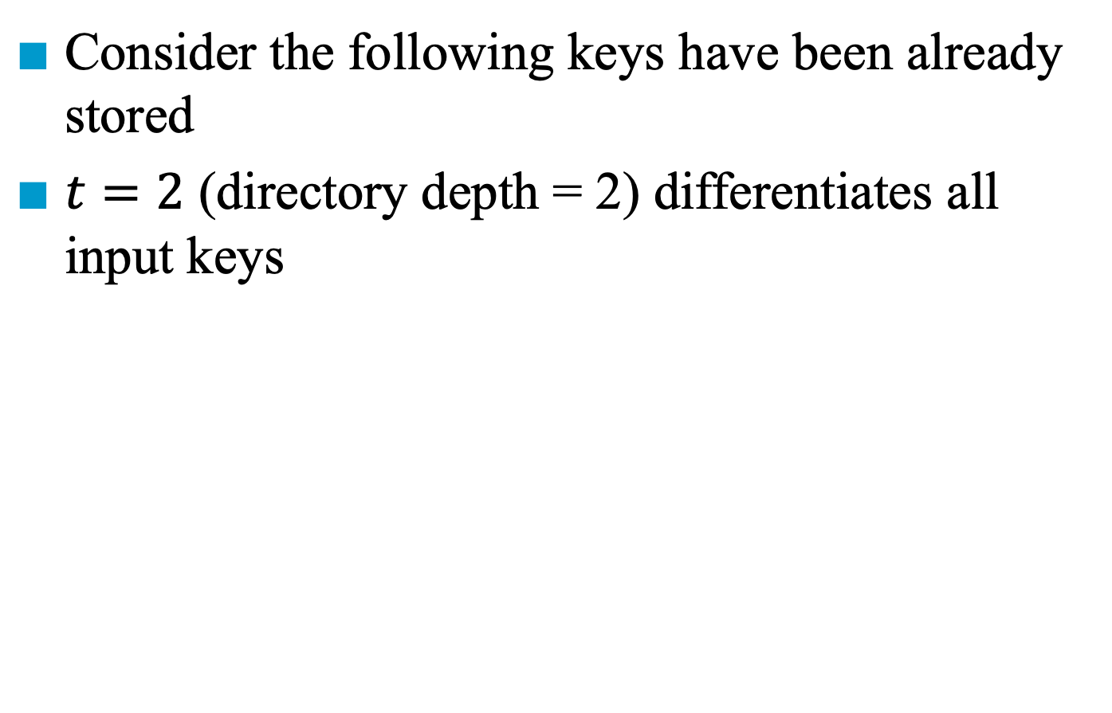
Extending the Directory
Consider the following keys have been already stored
$t=2$ (directory depth = 2) differentiates all input keys
Directory of pointers to buckets
k | h(k)
A0 | 100 000
A1 | 100 001
B0 | 101 000
B1 | 101 001
C2 | 110 010
C3 | 110 011
C5 | 110 101
00
A0 | B0
01
A1 | B1
10
C2
11
C3
d

Slide 23
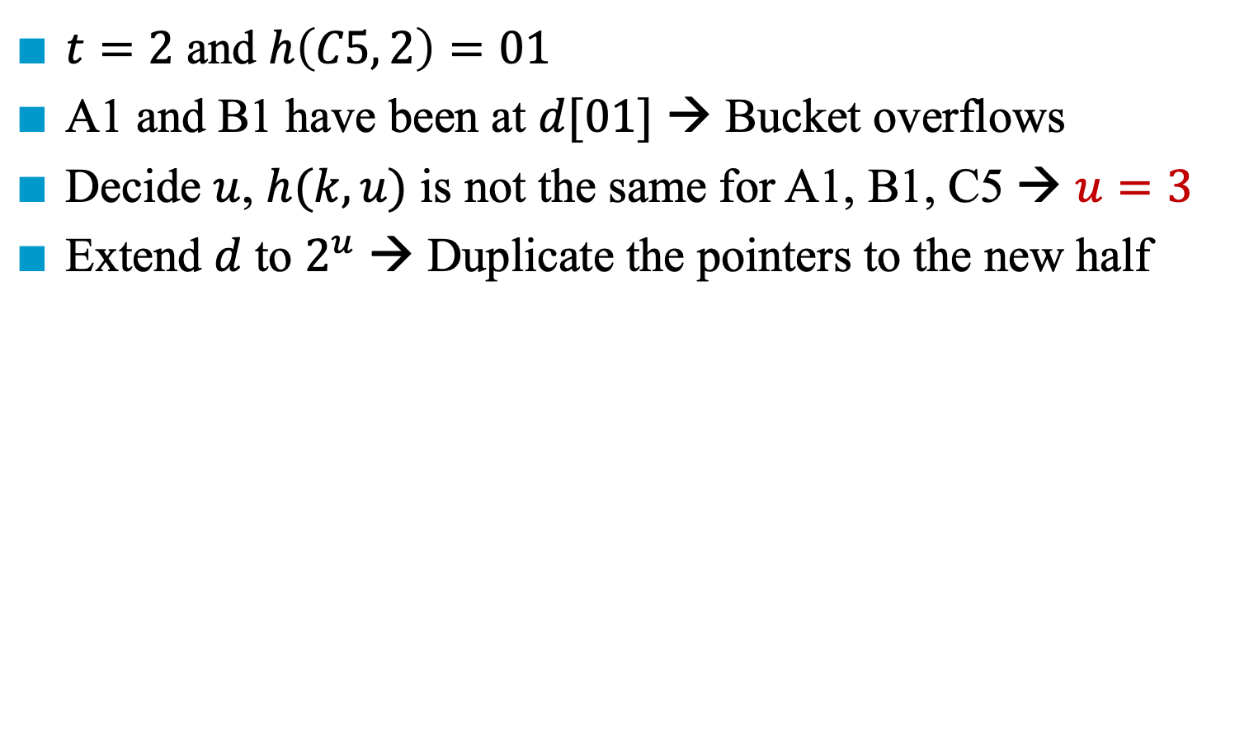
Insertion of C5 (=110 101)
$t=2$ and $h\left(C5, 2\right)=01$
A1 and B1 have been at $d[01]$ → Bucket overflows
Decide $u$, $h(k, u)$ is not the same for A1, B1, C5 → $u=3$
Extend $d$ to $2^{u}$ → Duplicate the pointers to the new half
Directory of pointers to buckets
k | h(k)
A0 | 100 000
A1 | 100 001
B0 | 101 000
B1 | 101 001
C2 | 110 010
C3 | 110 011
C5 | 110 101
000
A0 | B0
001
A1 | B1
010
C2
011
C3
100
101
u=3
110
111

Slide 24
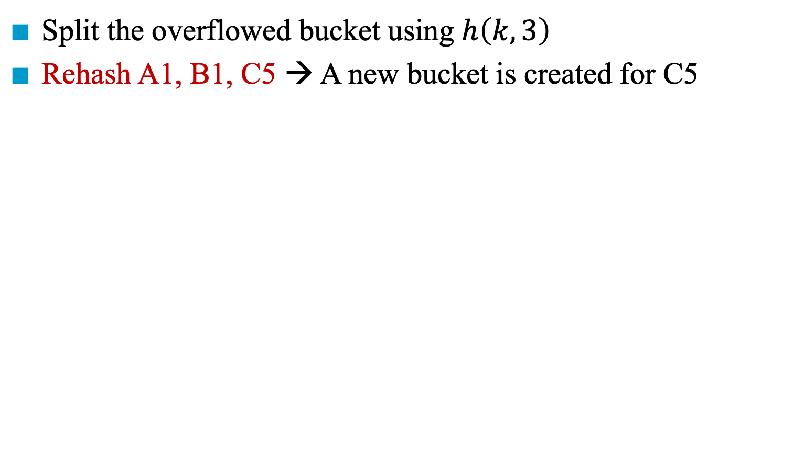
Insertion of C5 (=110 101)
Split the overflowed bucket using $h\left(k, 3\right)$
Rehash A1, B1, C5 → A new bucket is created for C5
000
A0 | B0
000
A0 | B0
001
A1 | B1
001
A1 | B1
010
C2
010
C2
011
C3
011
C3
100
100
101
101
C5
110
110
111
111
u=3

Slide 25
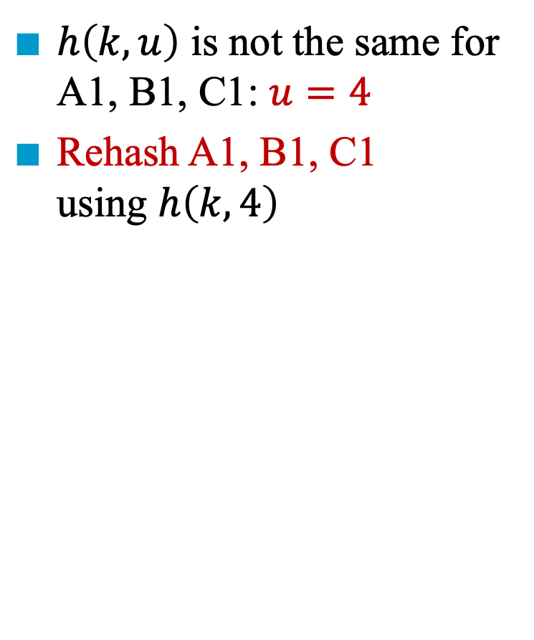
Insertion of C1 (=110 001)
0000
A0 | B0
$h\left(k, u\right)$ is not the same for A1, B1, C1: $u=4$
Rehash A1, B1, C1 using $h\left(k, 4\right)$
0001
A1 | C1
0010
C2
0011
C3
0100
0101
C5
k | h(k)
A0 | 100 000
A1 | 100 001
B0 | 101 000
B1 | 101 001
C2 | 110 010
C3 | 110 011
C5 | 110 101
C1 | 110 001
0110
0111
1000
1001
B1
1010
1011
1100
1101
1110
1111

Slide 26
Advantages for Dynamic Hashing Using Directories
Only double the directory rather than the whole hash table used in static hashing
Only rehash the entries in the buckets that overflows

Slide 27
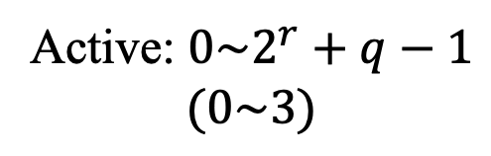
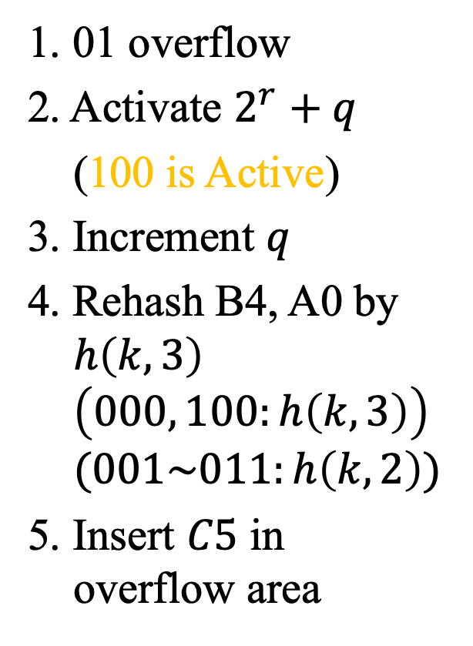
Directoryless Dynamic Hashing (1)
(b) Insert C5, r = 2, q = 1
(a) r = 2, q = 0
1. 01 overflow
2. Activate $2^{r}+q$
(100 is Active)
3. Increment $q$
4. Rehash B4, A0 by $h\left(k,3\right)$ $\left(000, 100:h\left(k,3\right)\right)$ $(001\sim 011:h\left(k,2\right))$
5. Insert $C5$ in overflow area
000 | A0 -
001 | A1 B5
010 | C2 -
011 | C3 -
100 | B4 -
overflow bucket
00 | B4 A0
01 | A1 B5
10 | C2 -
11 | C3 -
C5
new active bucket
Active: $0\sim 2^{r}+q−1$
$$(0\sim 3)$$

Slide 28
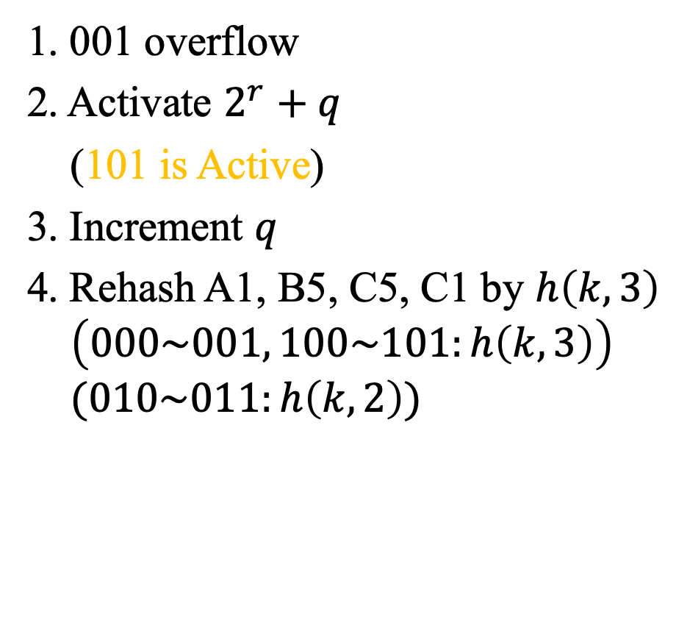
Directoryless Dynamic Hashing (2)
(b) Insert C1, r = 2, q = 2
1. 001 overflow
2. Activate $2^{r}+q$
(101 is Active)
3. Increment $q$
4. Rehash A1, B5, C5, C1 by $h\left(k,3\right)$ $\left(000\sim 001, 100\sim 101:h\left(k,3\right)\right)$ $(010\sim 011:h\left(k,2\right))$
000 | A0 -
001 | A1 C1
010 | C2 -
011 | C3 -
100 | B4 -
101 | B5 C5

